Slide 1
Swift Express
Courier Service using A*
AI Semester Project

Slide 2



Our Team
Fatima Tuzzahra
Muhammad Anees
Hunia Nadeem
FA20-BCS-019
FA20-BCS-045
FA20-BCS-024

Slide 3
Problem Statement
Often courier companies overprice their customers and are unreliable when it comes to utilizing the resources in a optimum manner to ensure timely service with minimum cost.

Slide 4
Project Scope
Swift Express, a Courier Service Company provide the most efficient and cost-effective delivery service within the country of Pakistan.
The system also provide tracking facility to ensure the timely and accurate delivery of all packages.
Swift Express also focuses on customer service and support, by using various ways of contact including an AI powered Chatbot for getting timely answers and necessary assistance.

Slide 5
Tools & Technologies
Tools | Technologies
VS Code IMB Watson Chatbot | Html, CSS, Bootstrap JavaScript Node Express MongoDB

Slide 6
System Functionalities
Package Delivery
Track Order
Shortest path is caluclated during package registration
Customers can track their packages
Customer Membership
Help Chatbot
Get Memberships to avail discounts
AI optimized customer service is available

Slide 7
System Limitations
Limited Franchises
1
3
2
Only Domestic Deliveries
No Air Transportation

Slide 8
Main System Modules
User Mode
Admin Mode
Can track order
Receive Customer Care Service
But discount memberships online
Manage new and old packages
Can track order
Generate shortest path to destination

Slide 9
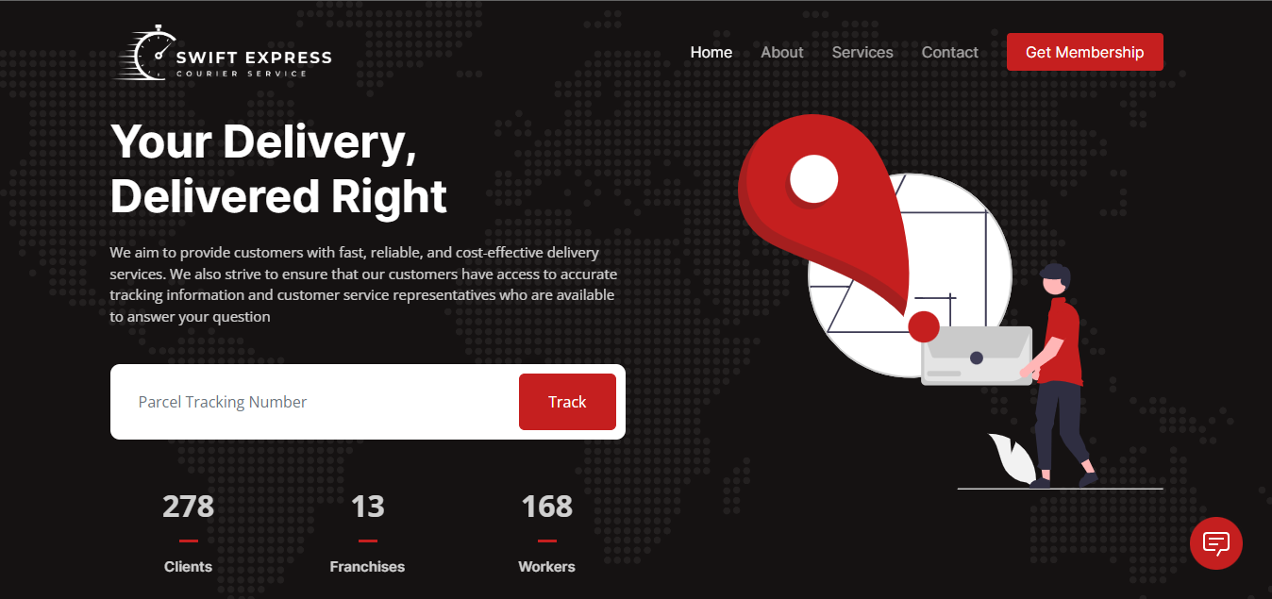
User Homepage

Slide 10
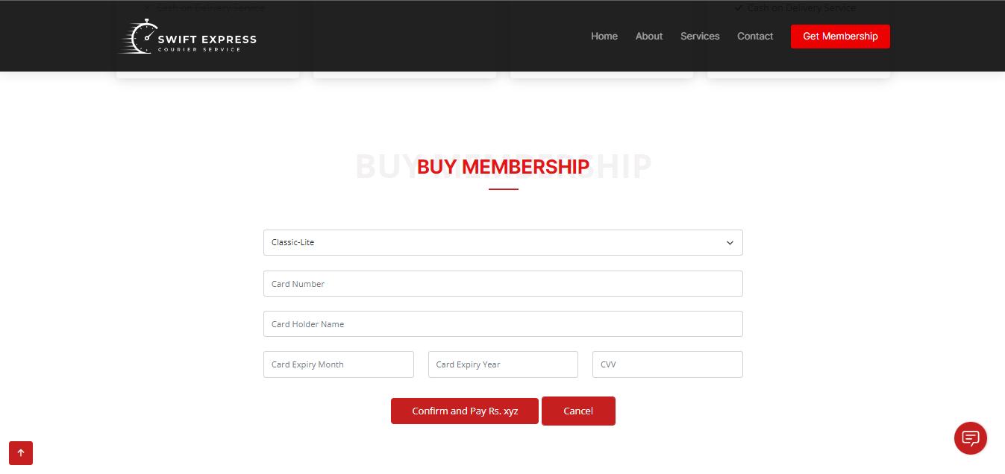
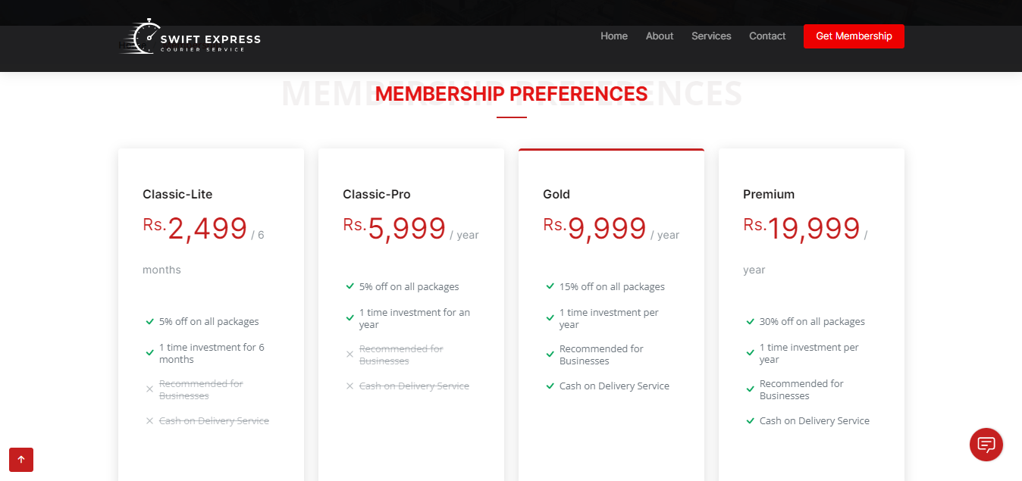
User Membership

Slide 11
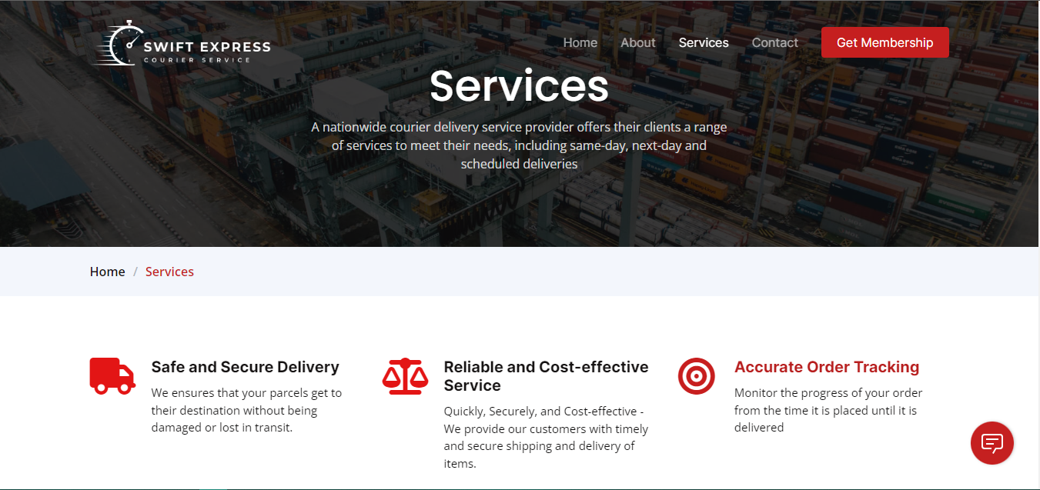
User Services Page

Slide 12
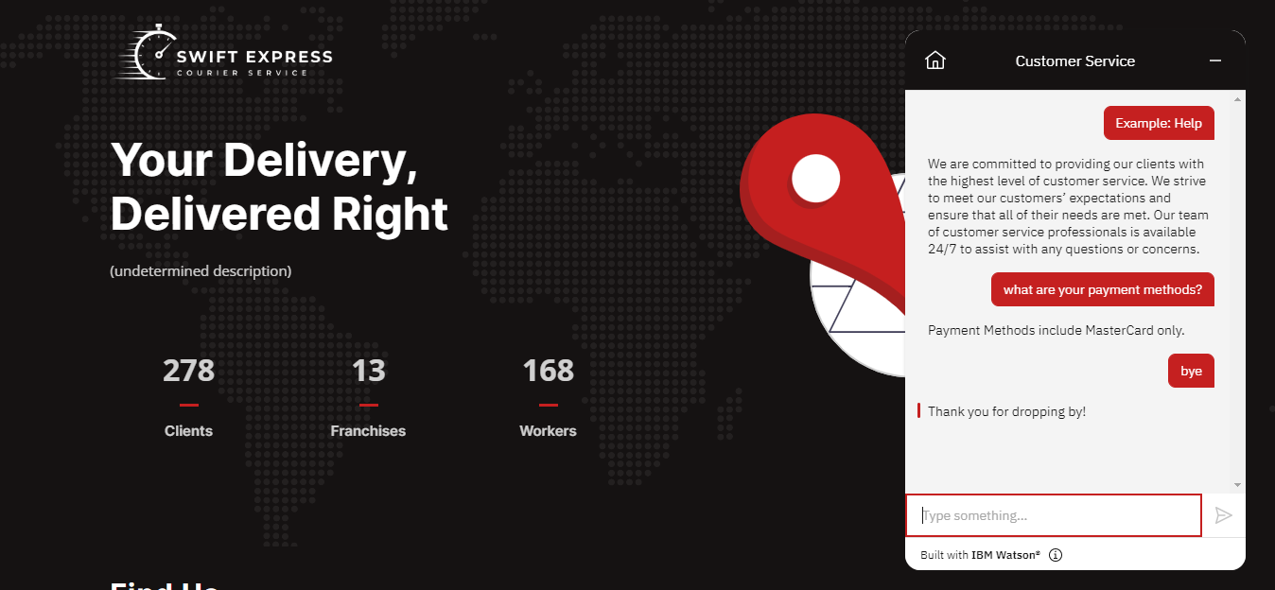
Chatbot Service

Slide 13
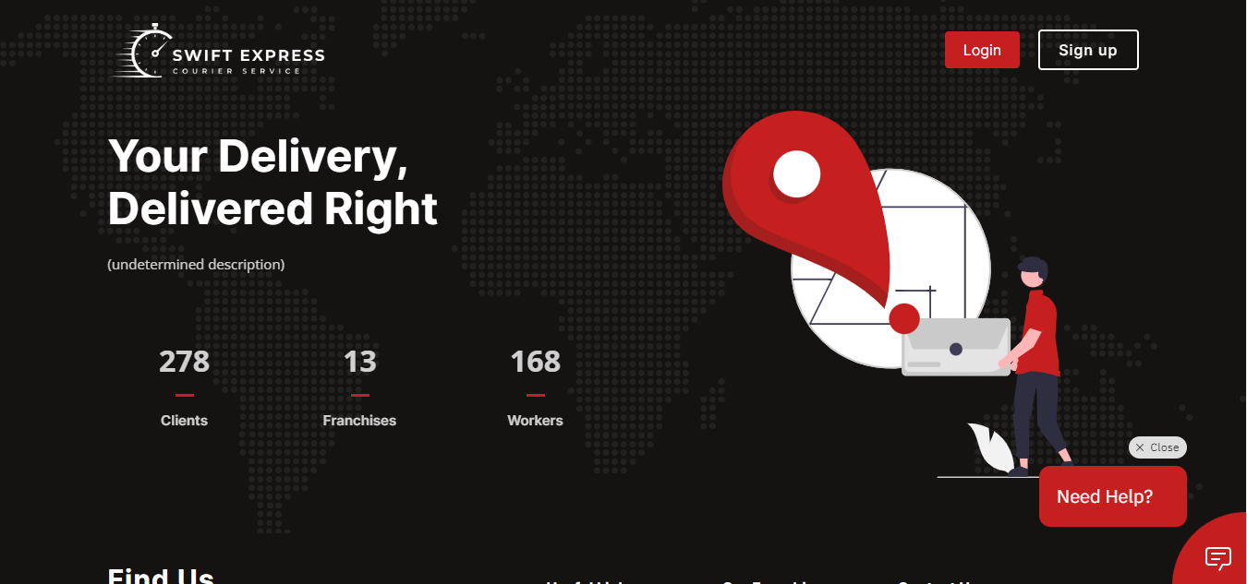
Admin Homepage

Slide 14
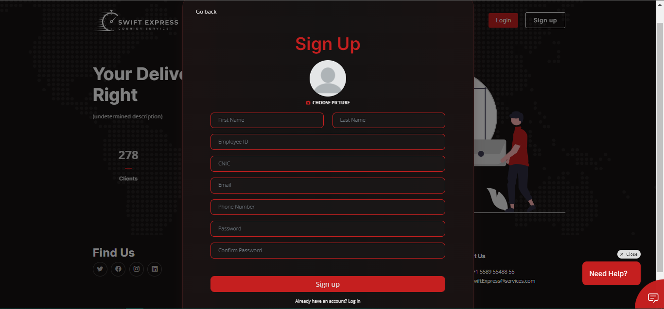
Admin Signup

Slide 15
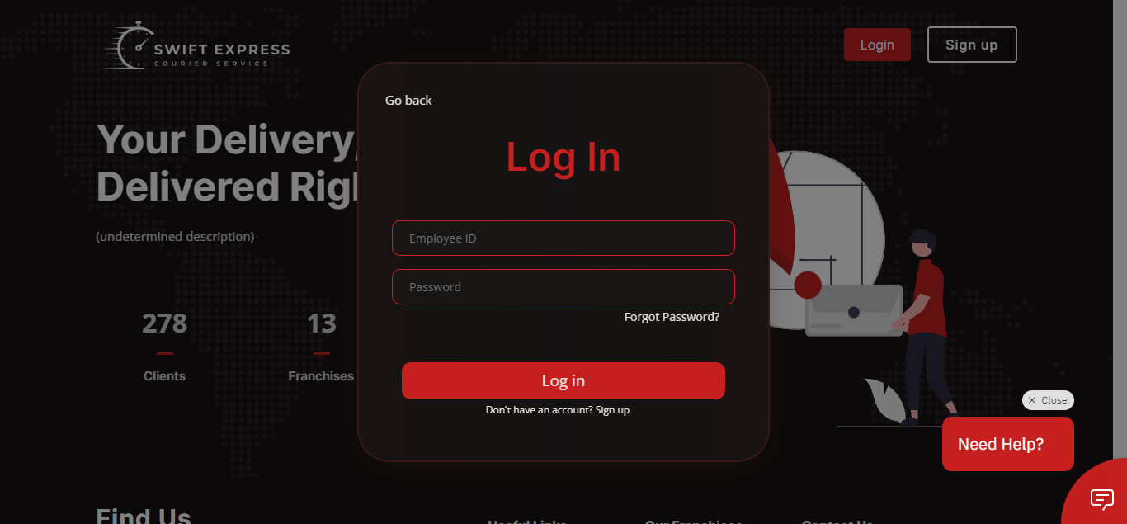
Admin Login

Slide 16
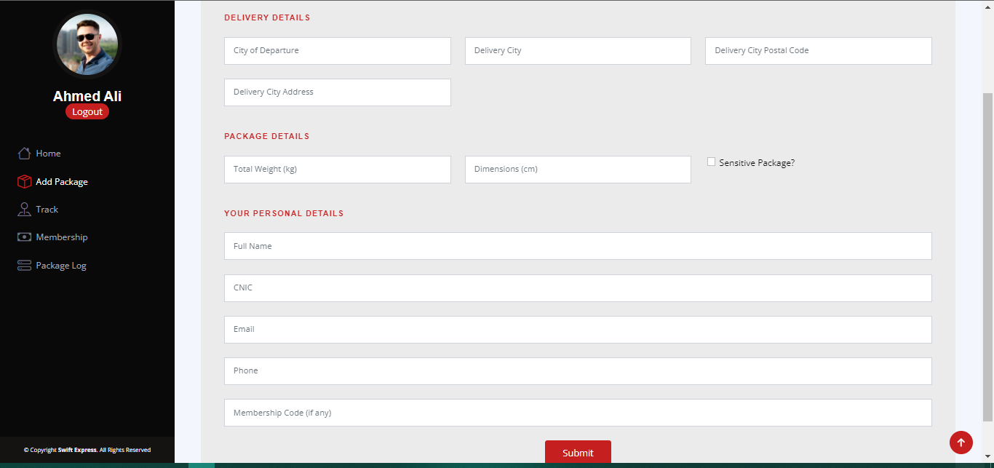
Admin Package Register

Slide 17
Thank You!
Any Questions?

